Slide 1


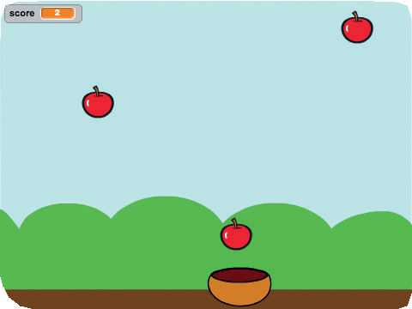
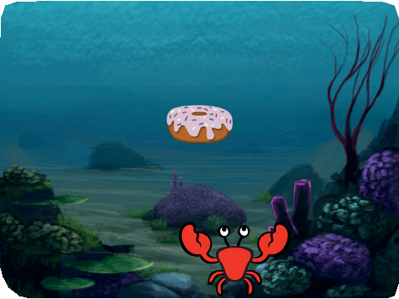
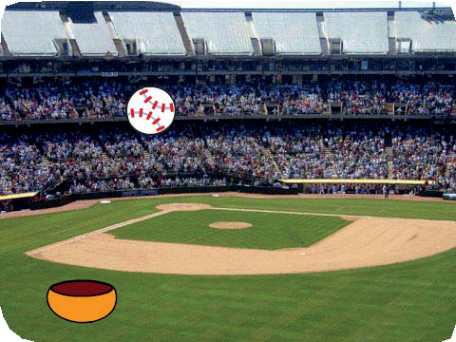
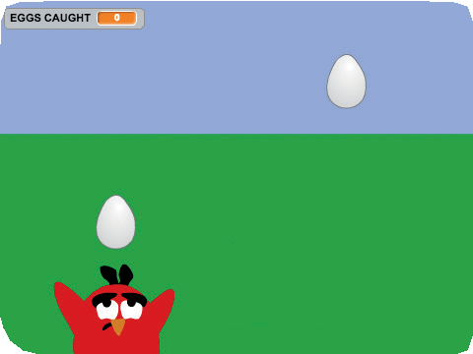

Catch Game Cards
Catch Game
Make a game where you catch things falling from the sky.
scratch.mit.edu/catch

Slide 2
Catch Game Cards
Catch Game
Use these cards in this order:
Go to the Top Fall Down
Move the Catcher Catch It!
Keep Score Bonus Points You Win!
1
2
3
4
5
6
7
scratch.mit.edu/catch

Slide 3
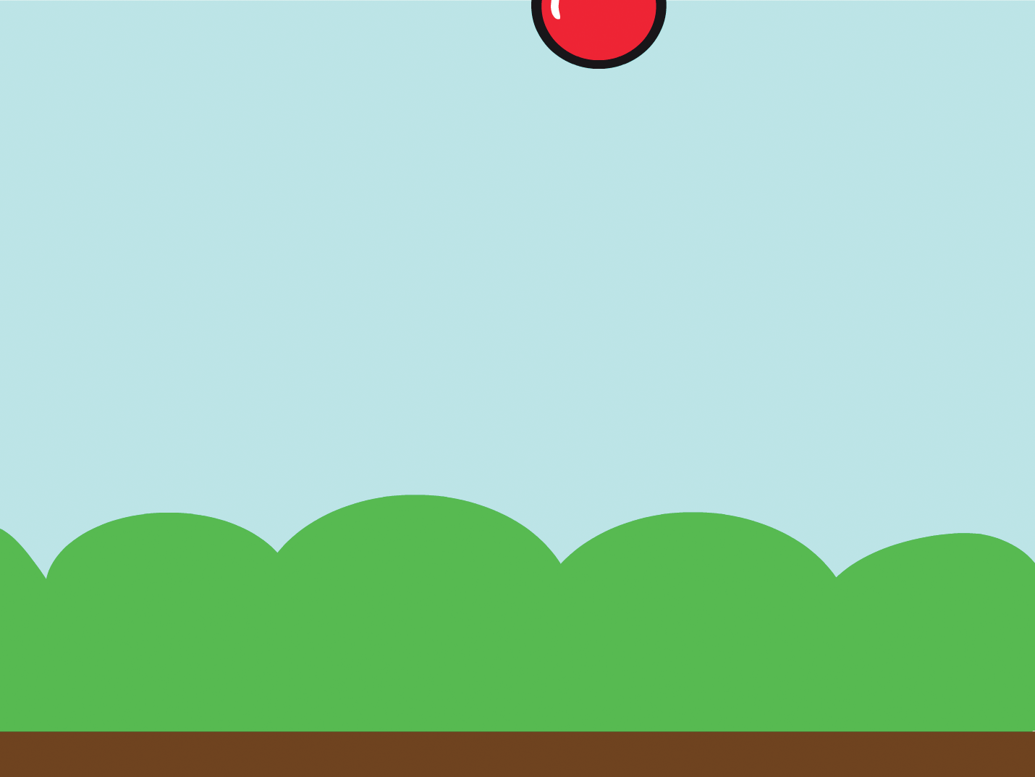
Go to the Top
Start from a random spot at the top of the Stage.
Catch Game
1

Slide 4


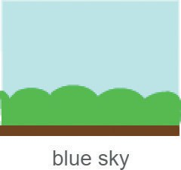


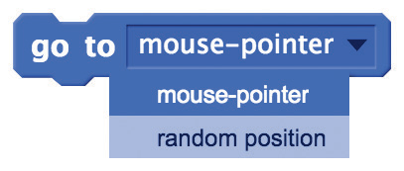
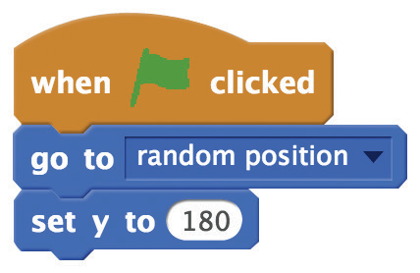


Go to the Top
scratch.mit.edu/catch
GET READY
Choose a sprite, like Apple.
Choose a backdrop.
ADD THIS CODE
Choose random position
from the menu.
Type 180 to go to the top of the Stage.
TRY IT
Click the green flag to start.
TIP
y is the position on the Stage from top to bottom.
y = 180
x = –240
x = 240
y = –180

Slide 5

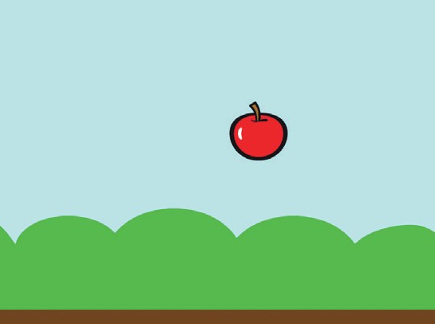

Fall Down
Make your sprite fall down.
Catch Game
2

Slide 6

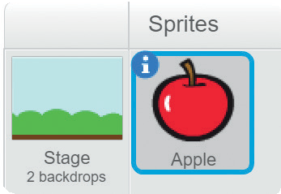
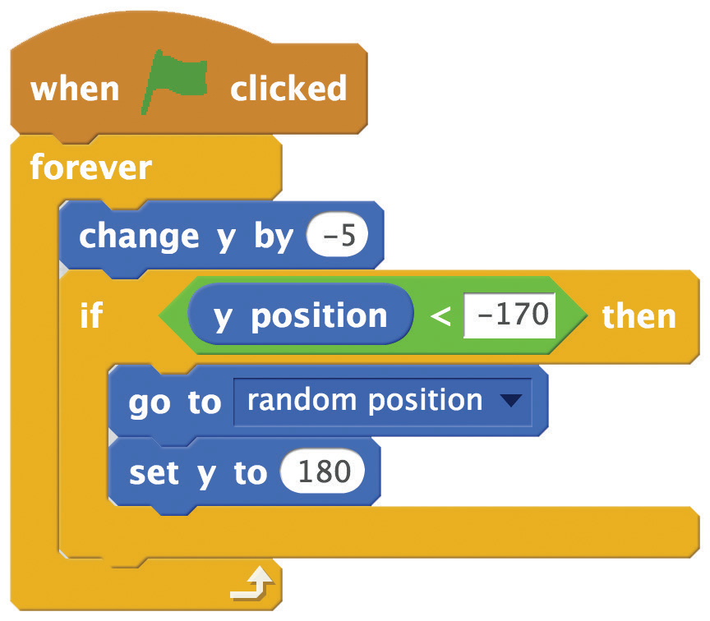



Fall Down
scratch.mit.edu/catch
GET READY
Click to select the Apple.
ADD THIS CODE
Type a negative number to fall down.
Check if near the bottom of the Stage.
Go back to the top of the Stage.
TRY IT
Click the green flag to start.
Click the stop sign to stop.
TIP
to move up or down.
Use
Use
to set the sprite’s vertical position.

Slide 7
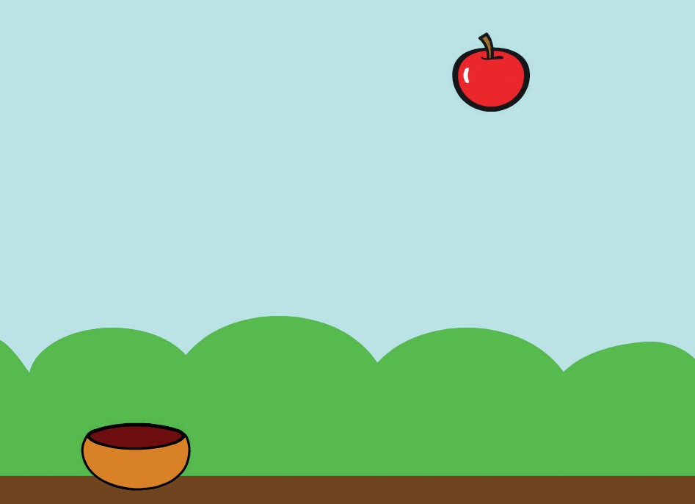
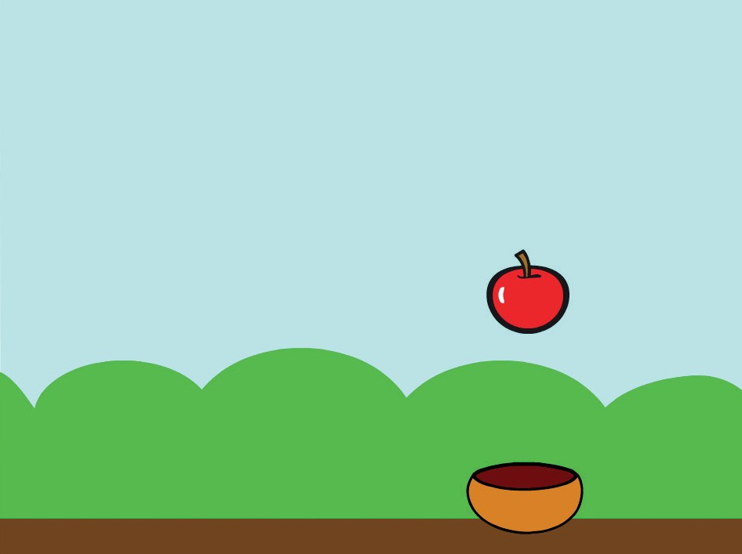
Move the Catcher
Press the arrow keys so that the catcher moves left and right.
Catch Game
3

Slide 8
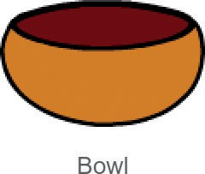

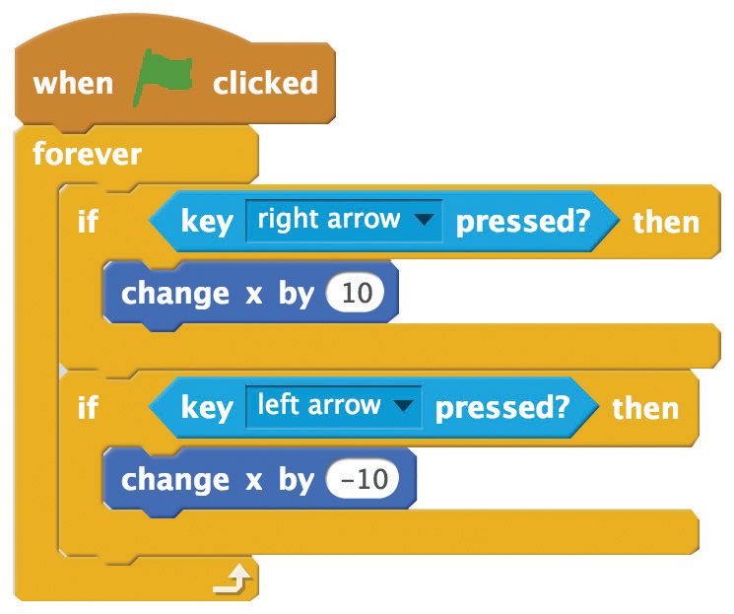

Move the Catcher
scratch.mit.edu/catch
GET READY
Choose a catcher, like Bowl.
Drag the Bowl to the bottom of the Stage.
ADD THIS CODE
TRY IT
Click the green
flag to start.
Press the arrow keys to move the catcher.

Slide 9
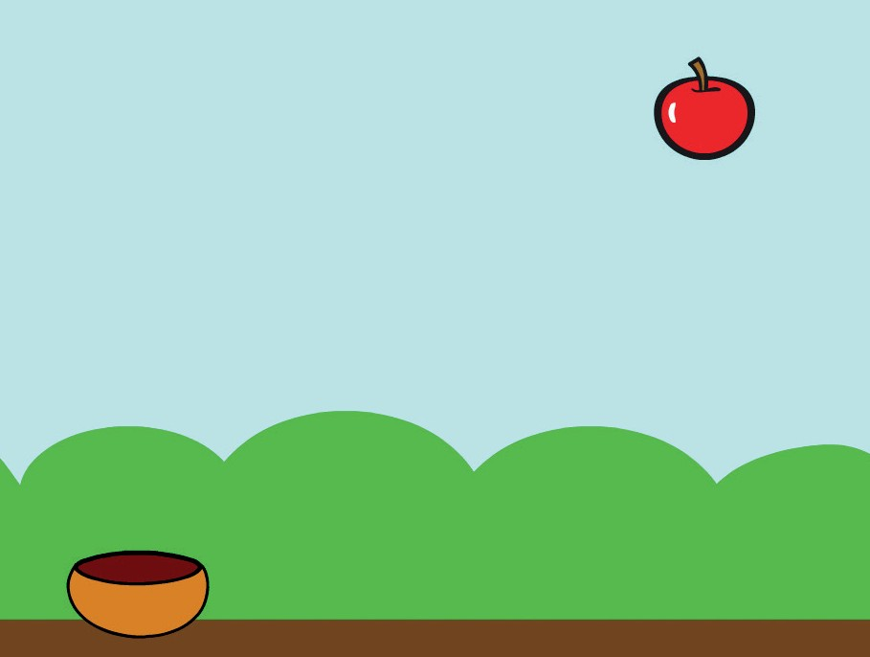

Catch It!
Catch the falling sprite.
Catch Game
4

Slide 10

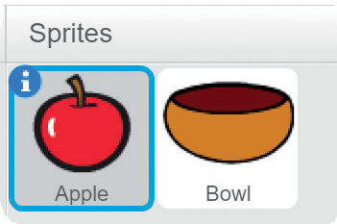
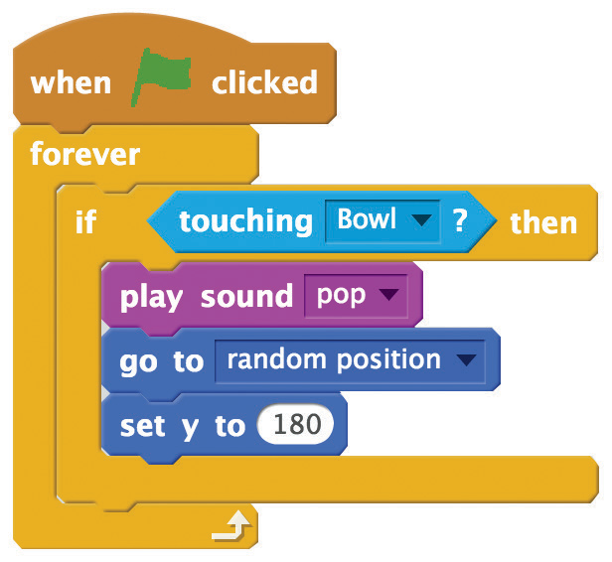


Catch It!
scratch.mit.edu/catch
GET READY
Click to select the Apple.
ADD THIS CODE
Choose Bowl from the menu.
Choose a sound.
TIP
If you want to add a different sound, click the
tab.
Then choose a sound from the Sound library.

Slide 11
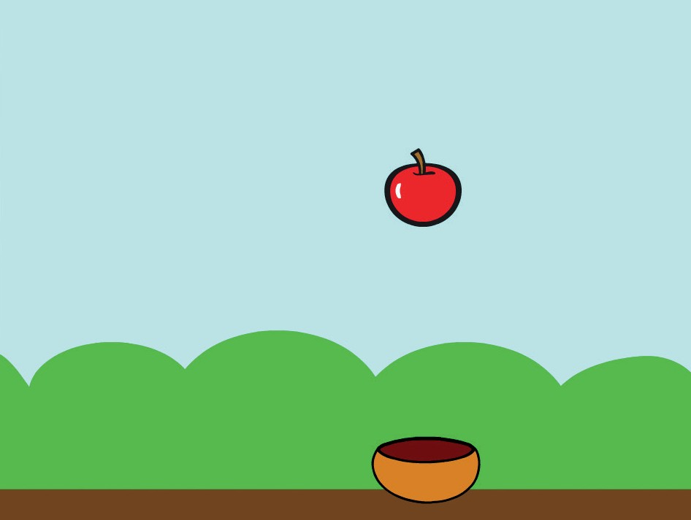



Keep Score
Add a point each time you catch the falling sprite.
Catch Game
5

Slide 12
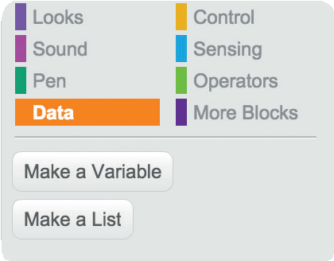
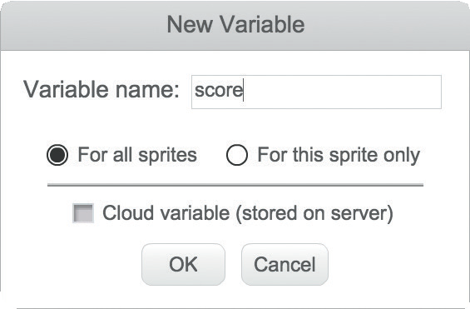

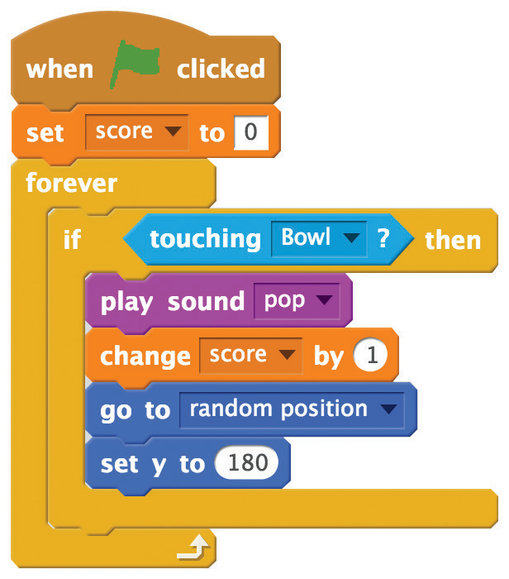
Keep Score
scratch.mit.edu/catch
GET READY
Choose Data.
Click the Make a Variable button.
Name this variable score
and then click OK.
ADD THIS CODE
Add two new blocks to your script:
Add this block to reset the score.
Add this block to increase the score.
TRY IT
Catch apples to score points!

Slide 13
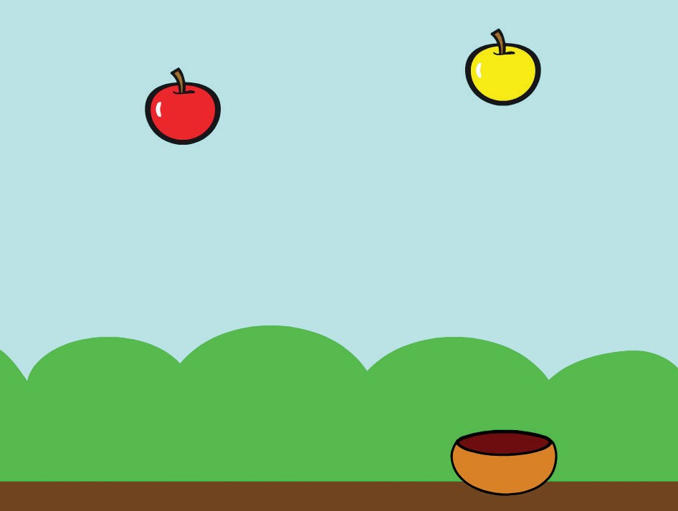
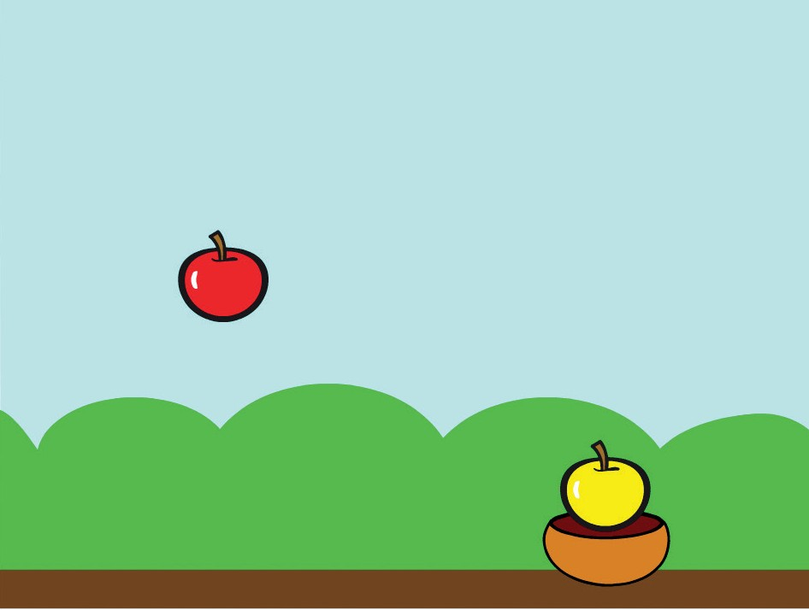

Bonus Points
Get extra points when you catch a golden sprite.
Catch Game
6

Slide 14


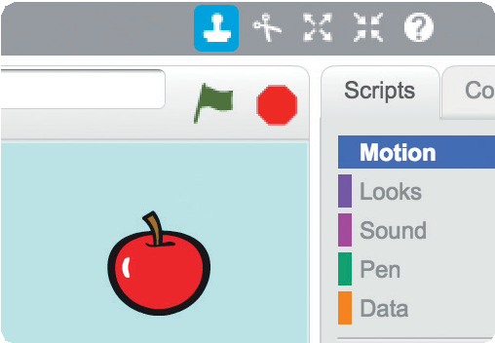
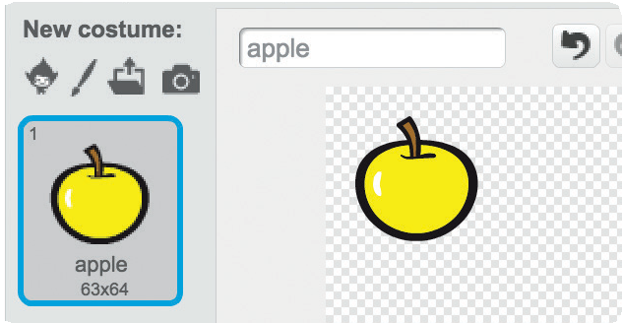



Bonus Points
scratch.mit.edu/catch
GET READY
Choose the Duplicate tool.
Click the
tab.
Click your sprite to duplicate it.
You can use the paint tools to make
your bonus sprite look different.
ADD THIS CODE
Click the tab.
Type how many points for the bonus sprite.
TRY IT
Catch your bonus sprite to increase your score!

Slide 15


You Win!
When you score enough points, display a winning message!
Catch Game
7

Slide 16




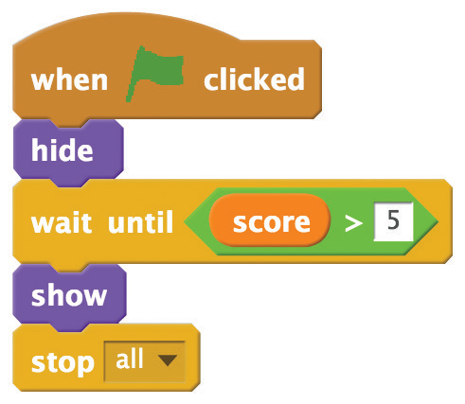

You Win!
scratch.mit.edu/catch
GET READY
Click the paintbrush to draw a new sprite.
Use the Text tool to write a message, like “You won!”
Click the Convert to vector button.
You can change the font color, size, and style.
ADD THIS CODE
Click the tab.
Insert the score block.
TRY IT
Click the green
flag to start.
Play until you score enough points to win!

